Slide 1

Machine Learning Using Python Frameworks
Lorcan Williamson

Slide 2
Introduction
Machine learning has advanced in recent years due to increases in computer capabilities
This project’s aim is to look at the landscape of machine learning using python frameworks.
This presentation will show my plans for this project.

Slide 3
Project plan
This project will explore the frameworks by solving 3 example problems of different types.
Image detection
Classification
Regression
These examples will cover a number of features of these frameworks, such as data pre-processing and various machine learning algorithms.

Slide 4
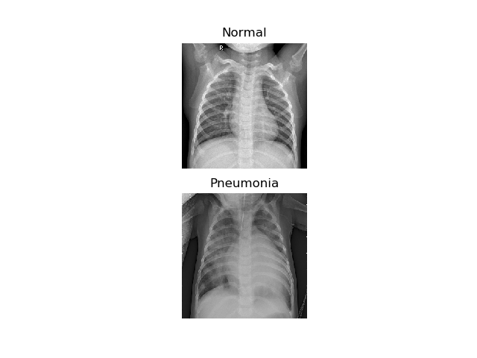
Detecting Pneumonia
Pneumonia is disease that causes an inflammation of the lungs.
It is responsible for around 5% of deaths in Ireland annually.
Machine learning has been used to achieve diagnosis rates comparable to doctors for diseases such as pneumonia.
This problem should allow for demonstration of CNNs, class balancing, and different accuracy metrics.

Slide 5
Predicting Student Performance
This example problem looks to predict student test scores based on a number of factors, such as;
Parents occupation
Family size
Social life.
This problem was chosen as it should offer a good example of data reduction and augmentation techniques, and many common machine learning algorithms are applicable

Slide 6
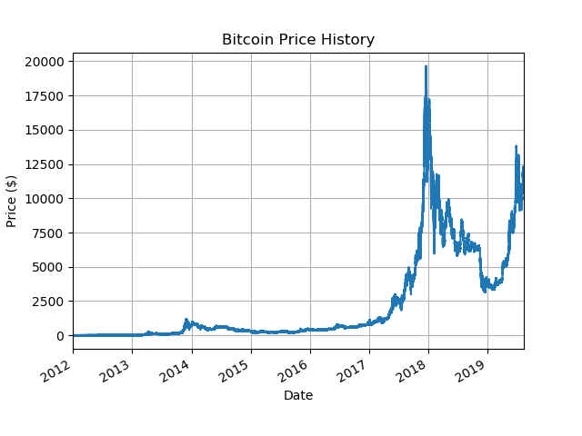
Forecasting Bitcoin Prices.
Machine learning is often used by stock brokers and investors.
It can be used to forecast prices or automatically trade stocks.
This problem was chosen to demonstrate regression, and forecasting using time-series data.

Slide 7
Action Plan
Each problem has been split into 4 steps;
Exploring the dataset (5 days)
Researching related problems (7 days)
Developing code (14 days)
Testing final model (2 days)

Slide 8
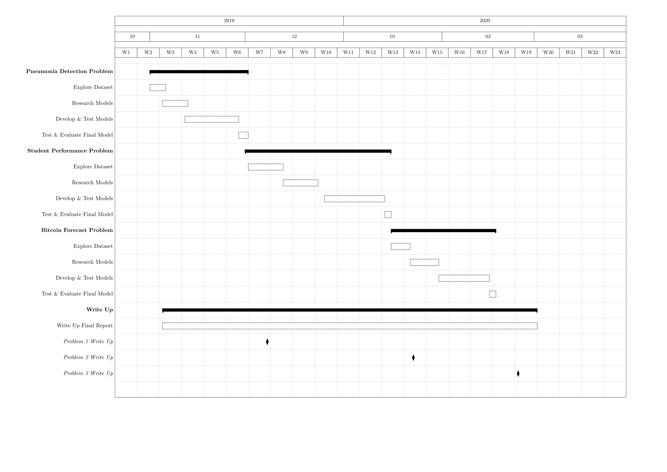
Action Plan

Slide 9
Conclusion
This project shall be looking at common machine learning frameworks in Python.
It will do this through by developing code for example problems.
These problems being;
Detecting pneumonia
Predicting student performance
Forecasting bitcoin prices

Slide 10
Questions?

